Slide 1


Software Engineering and Project Management
(21CS61)
Links and Association
Submitted By: Keerthan MS 4SF21IS039
Department of Information Science and Engineering

Slide 2
Links
Link: A link is an instance of an association. It connects specific instances of classes, representing a concrete relationship between objects.
In UML, while an association describes a relationship at the type level (i.e., between classes), a link describes a relationship at the instance level (i.e., between objects).

Slide 3
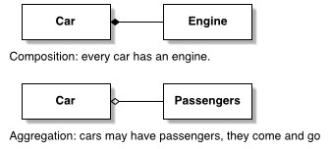
Links

Slide 4
Associations
An association represents a relationship between two or more classes that defines how objects of those classes can interact with each other.
This relationship can describe various types of connections, such as one-to-one, one-to-many, or many-to-many.
Example : Imagine the relationship between a doctor and a patient. A doctor can be
associated with multiple patients.

Slide 5
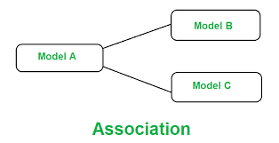
Associations
5

Slide 6
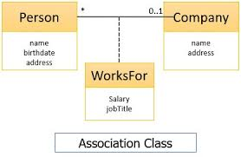

Slide 7

Bags and Sequences
A bag is a collection of elements with duplicates allowed .
A sequence is an ordered collection of elements with duplicates allowed.

Slide 8
Multiplicity And Directionality
Multiplicity: Indicates how many instances of one class can be associated with instances of another class.
Example : one-to-one, one-to-many, many-to-many.
Directionality: Associations can be unidirectional (one class knows about the other) or bidirectional (both classes know about each other).
Example: A Customer class might have an association with an Order class, indicating that a customer can place multiple orders.
6

Slide 9
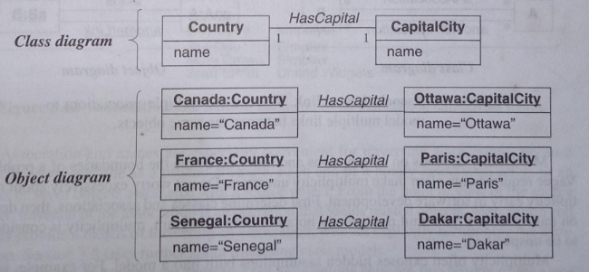

Slide 10
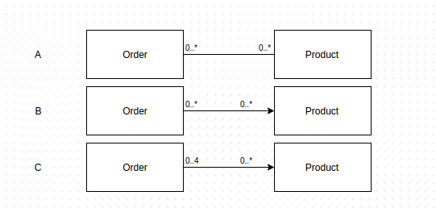
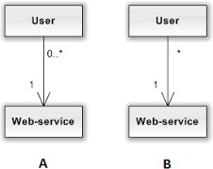
Multiplicity:
7

Slide 11
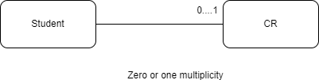
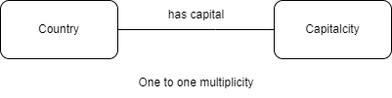
8

Slide 12
Generalization and Inheritance :
Generalization and inheritance are fundamental concepts in object- oriented programming (OOP) and design. These concepts help to create more reusable, scalable, and maintainable code by establishing relationships between classes and defining common behaviors.
Example: Suppose we have Cat and Dog classes. Both have common characteristics such as name, age, and methods like eat(), and sleep(). We can generalize these into a Pet superclass.
9

Slide 13
Inheritance
Inheritance: In object-oriented programming, inheritance is a mechanism where a new class (derived or subclass) inherits the properties and behaviors (attributes and methods) of an existing class (base or superclass).
This allows for code reuse and the creation of a hierarchical relationship between classes.
Single Inheritance: A subclass inherits from one superclass.
Multiple Inheritance: A subclass inherits from more than one superclass (not supported in some languages like Java, but supported in Python).
10

Slide 14
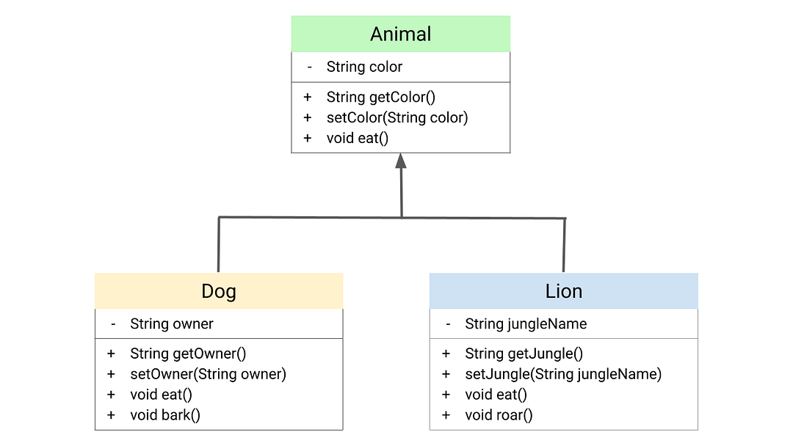

Slide 15
UML Designs :
A UML diagram is a way to visualize systems and software using
Unified Modeling Language (UML).
Software engineers create UML diagrams to understand the designs, code architecture, and proposed implementation of complex software systems.
UML diagrams are also used to model workflows and business processes.

Slide 16
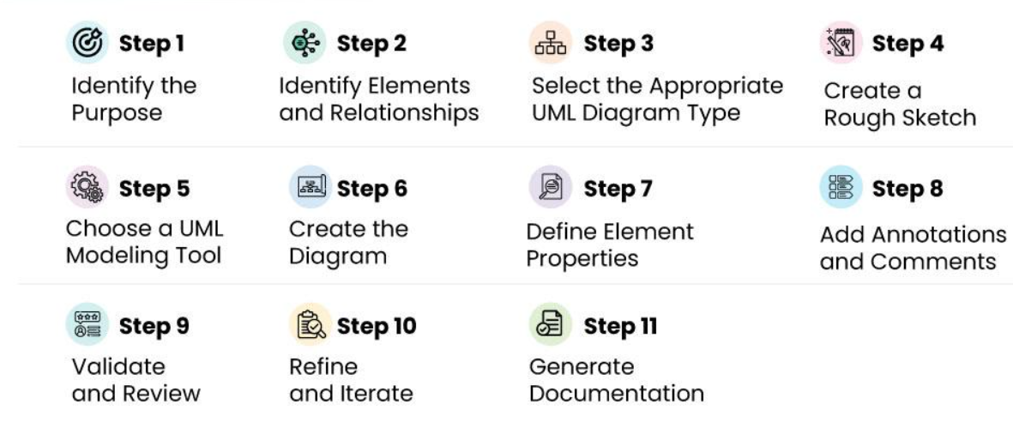

Slide 17
THANK YOU

